Slide 1



Slide 2
About today…
React hooks
useEffect
useRef

Slide 4

Side Effects
Side effects are operations that interact with external systems or directly modify the DOM
Examples
Fetching data from an API
Subscribing to external data sources
Setting up event listeners
Directly updating the DOM
etc

Slide 5

Introduction to useEffect
React hook used for managing side effects in functional components
Takes two arguments :
Effect function
This function contains the actual side effect logic you want to execute
Dependency array
This array determines when the effect function runs
Runs after every render and can perform cleanup on unmount

Slide 6

When Does useEffect Run?
By default (no dependency array), useEffect runs after every
render
With a dependency array :
The effect function runs only when the values in the array change
An empty dependency array ([]) makes the effect run only once after the initial render

Slide 7

Dependency Array
‘useEffect’ accepts a dependency array as the second argument
Specifies when the effect should run based on changes in its dependencies
Omitting the dependency array causes the effect to run after every render

Slide 8
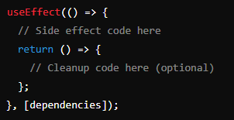
Syntax of useEffect
The arrow function inside ‘useEffect’ contains the side effect code
The optional cleanup function is returned to perform cleanup when the component
unmounts

Slide 9
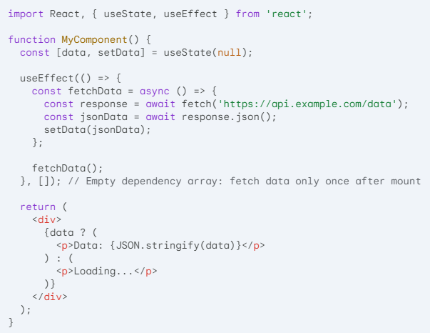
useEffect Data Fetching

Slide 11

Introduction to useRef
Provides a way to create references to DOM elements
Useful for scenarios where you need to access or
manipulate DOM elements directly

Slide 12

When to Use useRef
Storing references to DOM elements
Access and manipulate DOM elements directly
Managing focus
Control the focus state of form elements
Measuring DOM elements
Get the dimensions of DOM elements
Integrating with third-party libraries
Pass refs to third-party libraries that require DOM manipulation

Slide 13
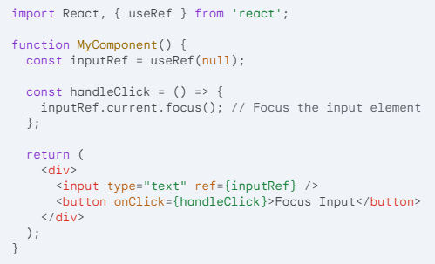
Example
This React component creates a text input and a button. Clicking the button focuses the input element using a reference stored in useRef

Slide 14


Slide 15

What is the primary purpose of useRef in React?
When does the useEffect hook with an empty dependency array run?
How can you access the current value of a DOM element referenced by useRef?
How can you ensure that a cleanup function runs when a component using useEffect unmounts?

Slide 16

Task 1
Create a component with an input and a button. Use useRef to store a reference to the input and useEffect (with an empty dependency array) to focus the input on component mount
Task 2
Create a component with a button. Use useRef to store a click count and useEffect (with a dependency array on the count) to console.log the current click count whenever the count changes

